Slide 1
Talk Less, Teach More Tactics for converting from lecture courses to active courses
Jeff Offutt
Software Engineering / Computer Science
http://www.cs.gmu.edu/~offutt/

Slide 2
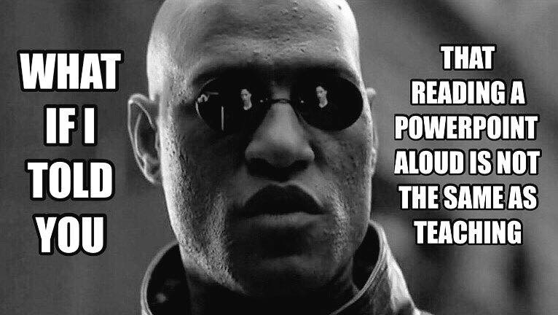

Slide 3
My Background
Professor of Software Engineering
28 years of teaching college classes
Chalk to white board to plastic slides to PPT
I like to lecture
I learned to lecture by learning to give research talks
But giving a research talk is
NOT THE SAME
as teaching !!

Slide 4
Lectures are not teaching
They are addictive
And slides become a crutch

Slide 5
Eric Mazur Taught Me Better
Students learn only slightly more from great lecturers than from average lecturers
Students learn a lot more from active learning exercises

Slide 6
Benefits of Active Exercises
More student engagement
Students stay awake—passively listening is hard !
Increased collaboration
An important and useful skill post-college
Many students enjoy learning together
Increased peer-learning
Students can learn a lot from each other
They can help each other work through difficult concepts and can often understand their difficulties better than professors do
Increased attendance
The return-on-investment analysis becomes much easier

Slide 7
But … Switching is Hard!
“Ya can’t teach an old dog new tricks.”
Habits die hard
We have huge investments in lectures
Lots of powerpoint slides
How do we manage this kind of change?

Slide 8
Thus, My Current Motto
Talk less; teach more
I’m trying to be self-persuasive …

Slide 9
How About You?
How many years have you been teaching ?
About what percentage of time do you spend lecturing vs. doing in-class work ?
What is your field ?

Slide 10
Case Study from My Class
SWE 632—User Interface Design and Development
Homework Review Exercise
Assignment was to evaluate the usability of an automated checkout system (out of class)
http://cs.gmu.edu/~offutt/classes/632/in-class/week3-eval1A.html

Slide 11
Types of Active Exercises
Discussion
Sometimes cognitive dissonance is best broken by peers
Writing
Fiction, non-fiction, understanding
Examples
Find or create examples to illustrate a concept
Analyze an example with respect to a concept
Problem-solving
Size of the problem ?
Support tools needed (calculator, computers, software, …) ?
Could be integrated with lecture or use a flipped classroom model
Games or role playing

Slide 12
Case Study from My Class
SWE 632—User Interface Design and Development
Examples Exercise
Mental model : A user’s expectation for how something should work
http://cs.gmu.edu/~offutt/classes/632/in-class/week3-mentalModel.html

Slide 13
Common Questions—Discussion
Amount of time for exercises ?
Group size ?
Makeup of groups ?
Gender, age, major, cultural background, academic ability ...
Assigned or self-grouped ?
Same groups each meeting ?
Drawing out introverted and shy students
Ensuring everyone has a chance to speak up
Present results to class, submit to prof, or unshared?

Slide 14
Case Study from My Class
SWE 637—Software Testing
Problem-Solving Exercise
I changed a slide with an example to a setup for students to try the example themselves
https://cs.gmu.edu/~offutt/softwaretest/edition2/powerpoint/Ch07-1-2-overviewGraphCoverage-active.pptx

Slide 15
SWE 637—Problem-Solving
Node Coverage
TR =
Test Paths:
Node Coverage
TR = { 1, 2, 3, 4, 5, 6, 7 }
Test Paths: [ 1, 2, 3, 4, 7 ] [ 1, 2, 3, 5, 6, 5, 7 ]
Write down the TRs and Test Paths for these criteria
1
Edge Coverage
TR =
Test Paths:
Edge Coverage
TR = { (1,2), (1, 3), (2, 3), (3, 4), (3, 5), (4, 7), (5, 6), (5, 7), (6, 5) }
Test Paths: [ 1, 2, 3, 4, 7 ] [1, 3, 5, 6, 5, 7 ]
2
3
Edge-Pair Coverage
TR =
Test Paths:
Edge-Pair Coverage
TR = { [1,2,3], [1,3,4], [1,3,5], [2,3,4], [2,3,5], [3,4,7],
[3,5,6], [3,5,7], [5,6,5], [6,5,6], [6,5,7] }
Test Paths: [ 1, 2, 3, 4, 7 ] [ 1, 2, 3, 5, 7 ] [ 1, 3, 4, 7 ]
[ 1, 3, 5, 6, 5, 6, 5, 7 ]
4
5
6
7
Complete Path Coverage
Test Paths:
Complete Path Coverage
Test Paths: [ 1, 2, 3, 4, 7 ] [ 1, 2, 3, 5, 7 ] [ 1, 2, 3, 5, 6, 5, 7 ] [ 1, 2, 3, 5, 6, 5, 6, 5, 7 ] [ 1, 2, 3, 5, 6, 5, 6, 5, 6, 5, 7 ] …
Notes:
This may take awhile. EPC is a little confusing at first.
And don’t let them worry about CPC too long … if they don’t realize right away that it’s infeasible this turns into a “trick” question.

Slide 16
Challenges
Timing the class is harder with active exercises
The classroom infrastructure has a major affect
Tables, movable desks, immovable desks, rising rows
Encouraging collaboration can be challenging
Many students are not accustomed to collaboration
Some do not play well with others
Some students prefer competition
Encouraging diversity of thinking
A start of an argument or an opportunity for growth?
Changing your habits
Preparation and your experience in the classroom is very different
Your interaction—deciding when to step in

Slide 17
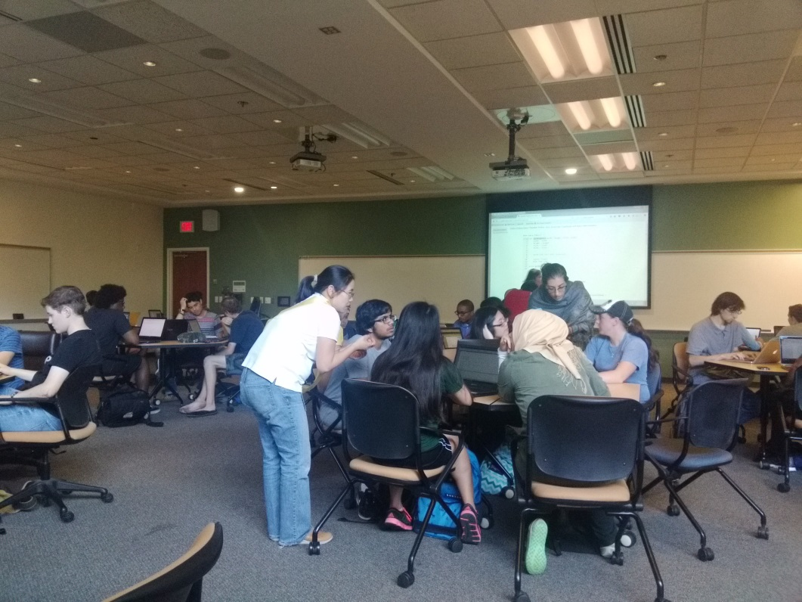
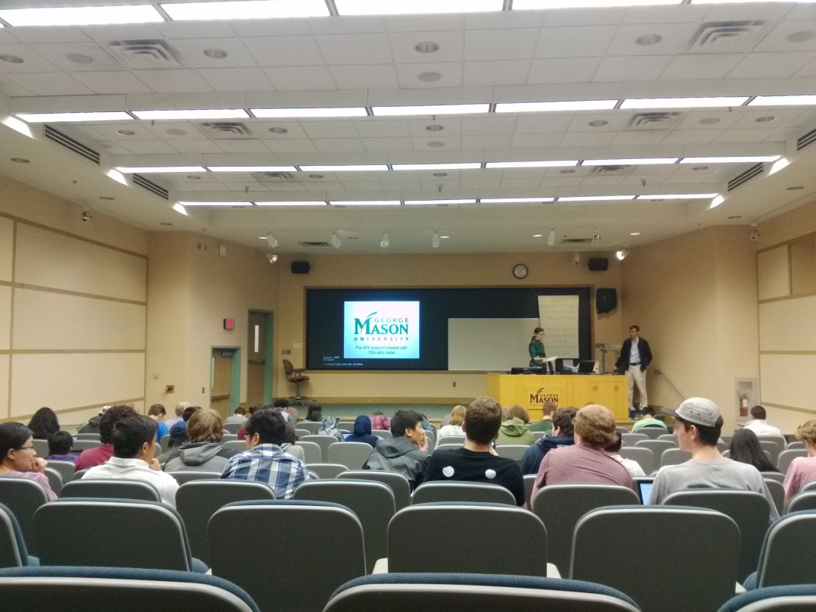
Classroom Layout Matters

Slide 18
Case Study from My Class
SWE 205—Software Usability Analysis and Design
A Game Exercise
Excise task : Something required as part of a process but that does not directly help us achieve our goal
http://cs.gmu.edu/~offutt/classes/205/in-class/OOtM-Excise-example.html

Slide 19
Open Discussion
Can you adapt these ideas to your classes?
Other questions you have?
Any other issues not covered?
Want to brainstorm some ideas?

Slide 20
Contact
Jeff Offutt
offutt@gmu.edu
http://cs.gmu.edu/~offutt/

