Slide 1
Peer Computing Expert Training Lesson 6 Active learning

Slide 2
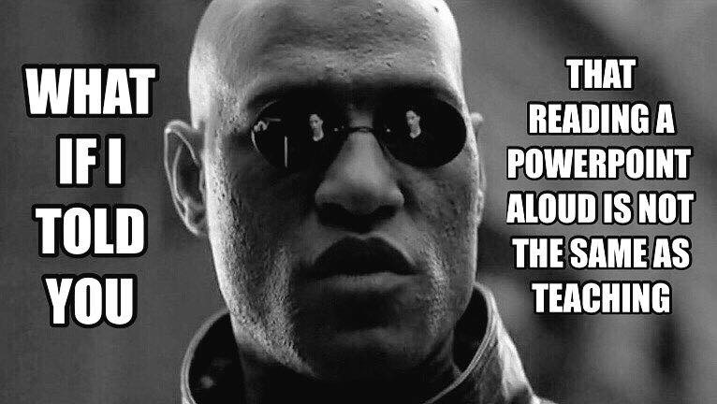

Slide 3
Lectures are not teaching
They are addictive
And slides become a crutch

Slide 4
Eric Mazur Taught Me Better
Students learn only slightly more from great lecturers than from average lecturers
Students learn a lot more from active learning exercises

Slide 5
Benefits of Active Exercises
More student engagement
Students stay awake—passively listening is hard !
Increased collaboration
An important and useful skill post-college
Many students enjoy learning together
Increased peer-learning
Students can learn a lot from each other
They can help each other work through difficult concepts and can often understand their difficulties better than professors do
Increased attendance
The return-on-investment analysis becomes much easier

Slide 6
Discuss
Have you taken classes with active learning exercises?
What active learning exercises have you seen that worked well?
… that did not work well?
Do active learning exercise work when students do not adequately prepare for class?

